Slide 1

Mathematica regina omnium scientiarum et – learning path to success
PHYSICS AROUND US
Activity for January 2018.

Slide 2
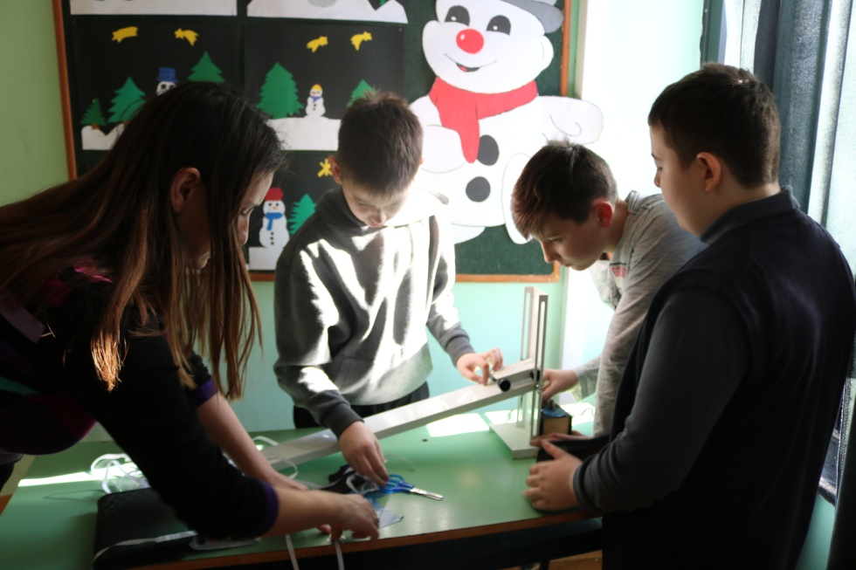
PHYSICS AROUND US
On 30th January we had a workshop called 'Physics around us'. The workshop was meant for 6th grade students who were getting to know Physics through experiments about physical phenomena and various processes that they encounter in everyday life.

Slide 3
PHYSICS AROUND US
The workshop was created to get students interested in Physics before they encounter it as a subject in 7th grade and also to show them the fun side of Physics thorugh creative learning, experimenting and scientific fun. Some of the experiments that students did:
A) Light reflection examination
B) Body balance
C) Experiments with magnets
D) Motion od body down the slope
E) Making of a rainbow
F) Sheaf system

Slide 4
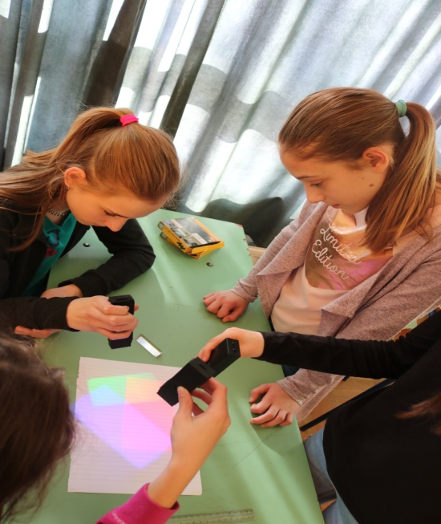
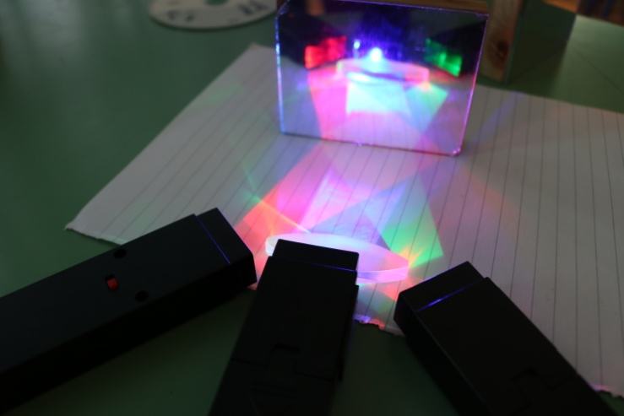
PHYSICS AROUND US
Light reflection examination
Students used a flat mirror and a light source to study the incoming angle and the angle of light reflection. They noticed incoming angle fits the reflection angle and in that way they realized and confirmed formation of a picure on a flat mirror.

Slide 5
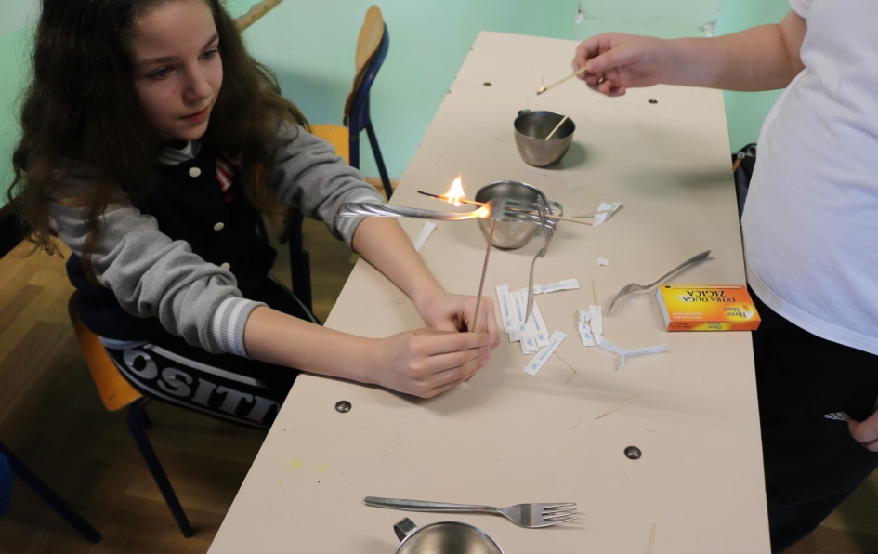
PHYSICS AROUND US
Body balance
Students studied balance and stability of the body and how it depends on the position of the center of gravity in the body. Using their own bodies as examples, but also with the help of simple examples they noticed that the center of gravity does not need to be in the body and that the balance depends on the size of the standfast.

Slide 6
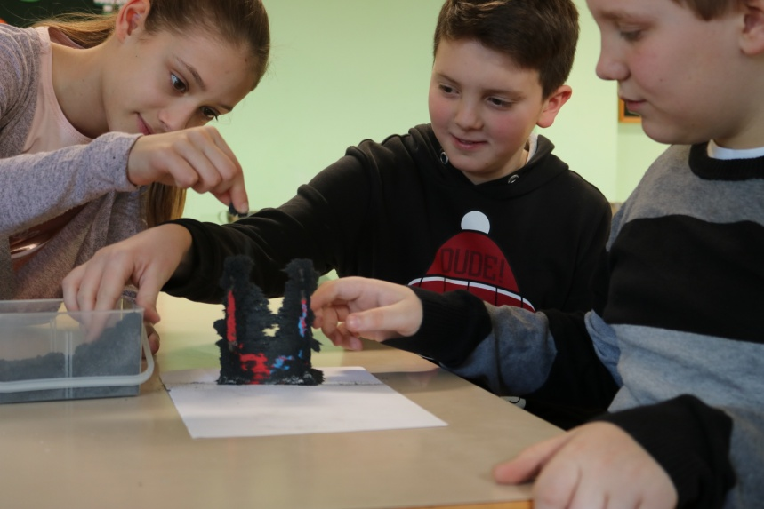
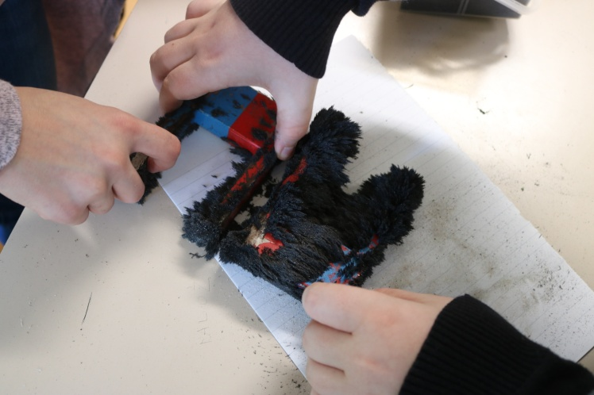
PHYSICS AROUND US
Experiments with magnets
With the help of the school magnets, the students demonstrated the attractive and repulsive magnetic force and made the magnetic field visible with the help of iron dust which made the shape and the direction of magnetic forces visible.

Slide 7
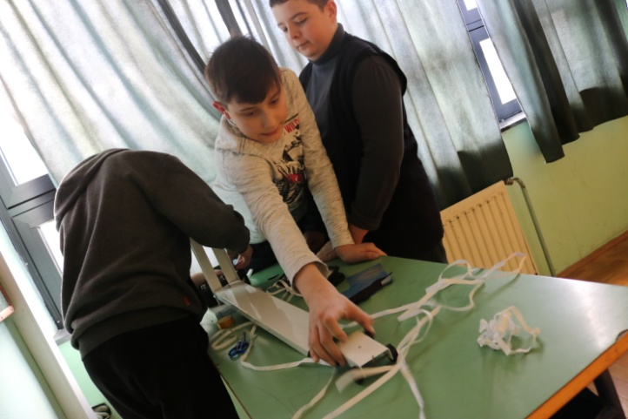
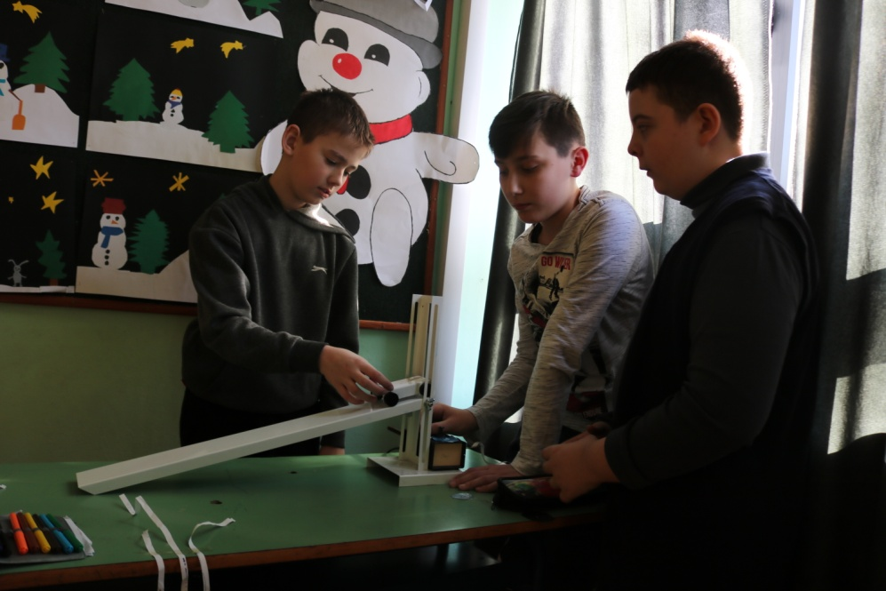
PHYSICS AROUND US
Motion od body down the slope
Students used a small electromagnetic push button to record the movement of a body down a slope. They watched how the distance between the little dots that the device leaves on the paper depends on the height from which the little car was pushed down. They also noticed that by increasing the height the velocity of the car increases too and by doing so the distance between the little dots gets bigger.

Slide 8
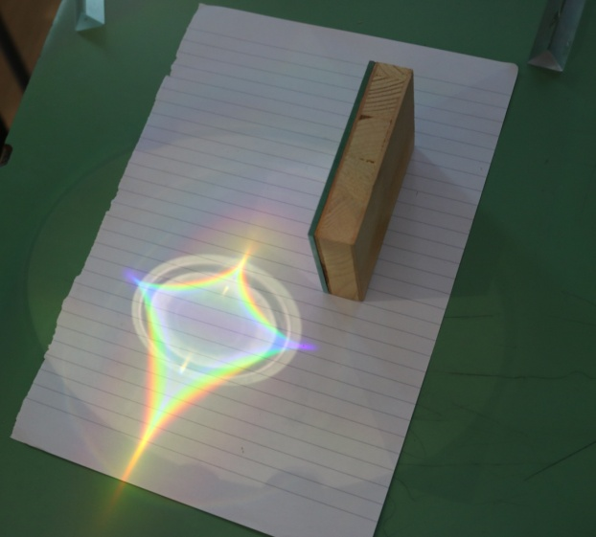
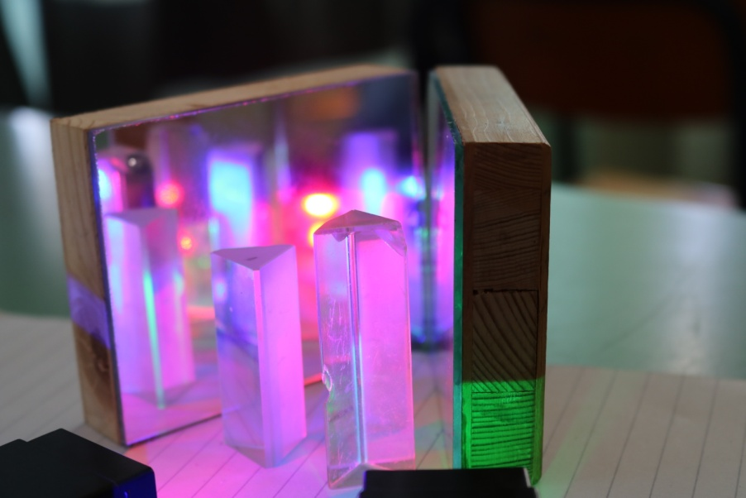
PHYSICS AROUND US
Making of a rainbow
Students used a litle prism and a source of light to make a rainbow. Before the experiment the students were offered a few primary colours sources of light with which they tried to get secondary colours, as many as possible. They noticed that the rainbow will be clearer if we use a stronger source of light (mobile phone) and if we choose a CD as a reflective surface in which to break the light.

Slide 9
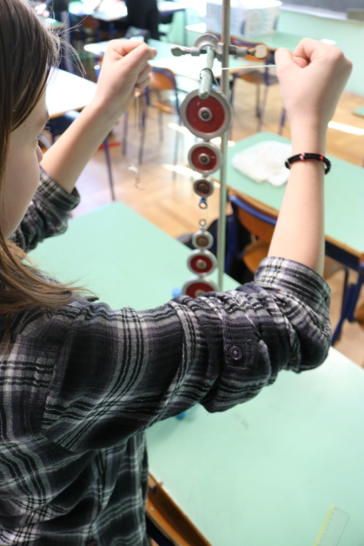
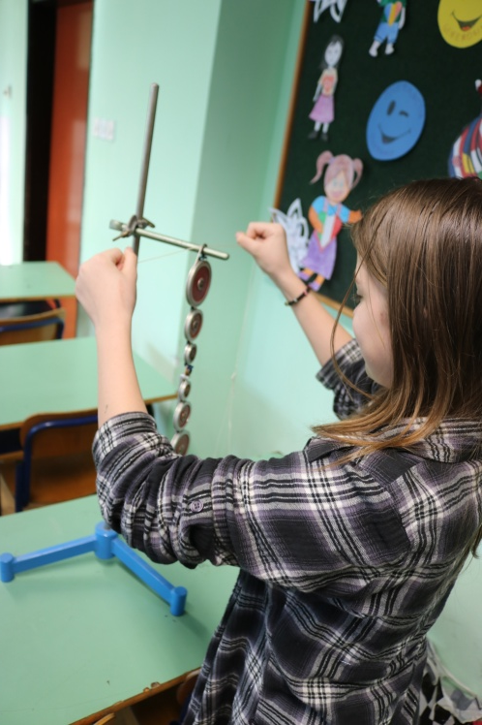
PHYSICS AROUND US
Sheaf system
Students used a sheaf to demonstrate how a smaller force can overpower a bigger, stronger force.
The experiments were created
by Physics teacher Martina Bukvić
and were documented by
a photo group led by
Math teacher Anita Jukić.

