Slide 1
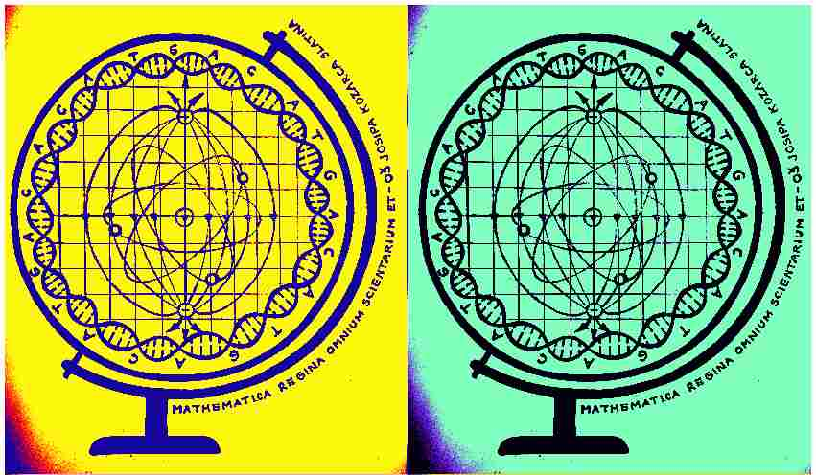
Mathematica regina omnium scientiarum et – learning path to success
Activity for May 2020
ONLY ONE EARTH

Slide 2
Only one EARTH – 'Green chemistry'
Descriptionof the activity
Students listened to a lecture about 'Green chemistry'. They learned about the principles of that project. They listened about the analysis of various cosmetic products or how to recognize harmful substances that can be found in them.
After that, the students checked their knowledge through a quiz with questions related to the topic.
In the questions students were supposed to recognize basic toxins which are most commonly found in cosmetics and know their harmful effects.

Slide 3
Here you can see the presentation and task/quiz for students in Croatian Made by our students and Chemistry teacher
a) Audio Power Point presentation (in Croatian)
https://drive.google.com/file/d/1ecGxyfZ-rOdnVCOhNKzLvgW7m4sW0rVg/view?usp=sharing
b) On-line task _ quiz
https://forms.office.com/Pages/ResponsePage.aspx?id=FvJamzTGgEurAgyaPQKQkZEH1YM9kTlJi-4wKFcISjRUNUlRS1lWS0hONzFIQkZIOTU1WUhJQlE1OS4u

Slide 4
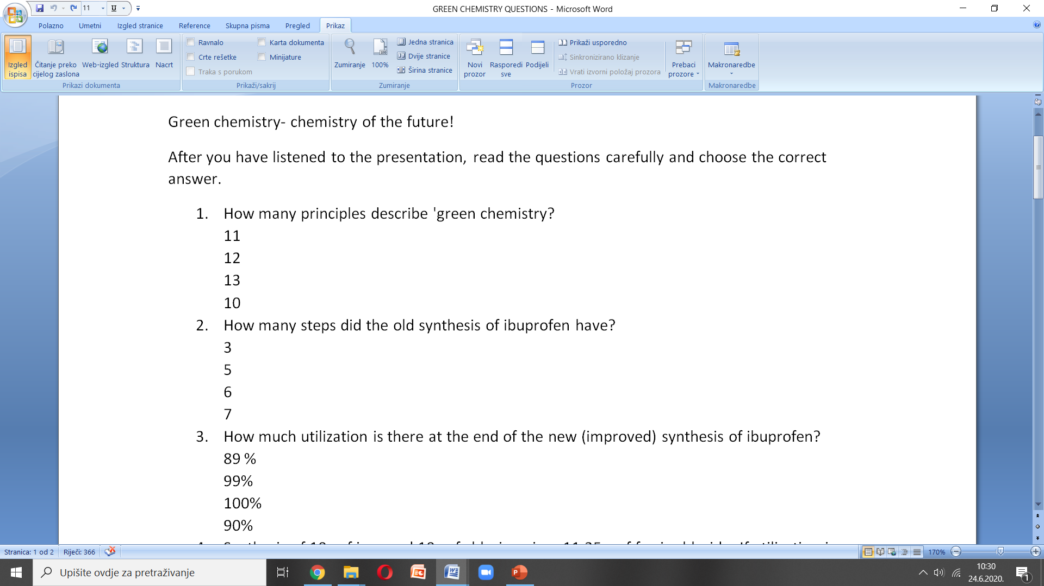
Here you can read the questions in English…

Slide 5
... in which you can find a correlation with mathematics

Slide 6
What we have achieved with online activity
Aim of the activity:
Raise awareness of the students about the harmfulness of certain toxins and teach them about healthier alternatives
Motivation for the activity comes out of the fact that nowadays more and more cosmetics are made harmful and dangeroues chemicals. With a little education you can find a much better option so that you do not gather toxins in your blood with years of using a certain products.
Modern methods of work: Encourage students to think about healthier options when it comes to cosmetics used on a daily basis and to check what they have learned by using the Office tool 'Forms'
Teaching aims: After the workshop students are able to differentiate good from bad ingredients in cosmetics and have the ability to read the declarations which contain the substances found in the products. In that way, the students will become more aware and be able to act 'greener'.
Results of the activities:
A Powerpoint presentation on the topic of 'Green chemistry' as well as a knowledge quiz which students used to check how much they have learned.
Activity evaluation: Students graded the activity with stars (1-5).

Slide 7
Additionally:
The activity is created and accomplished by Chemistry teacher Silvija Bašić and Math teacher Anita Jukić in cooperation with English teacher Dražena Vujanović.

