Slide 1
Mathematica regina omnium scientiarum et – learning path to success
MATHEMATICS AND WHAT ELSE
Activity for December 2017.

Slide 2
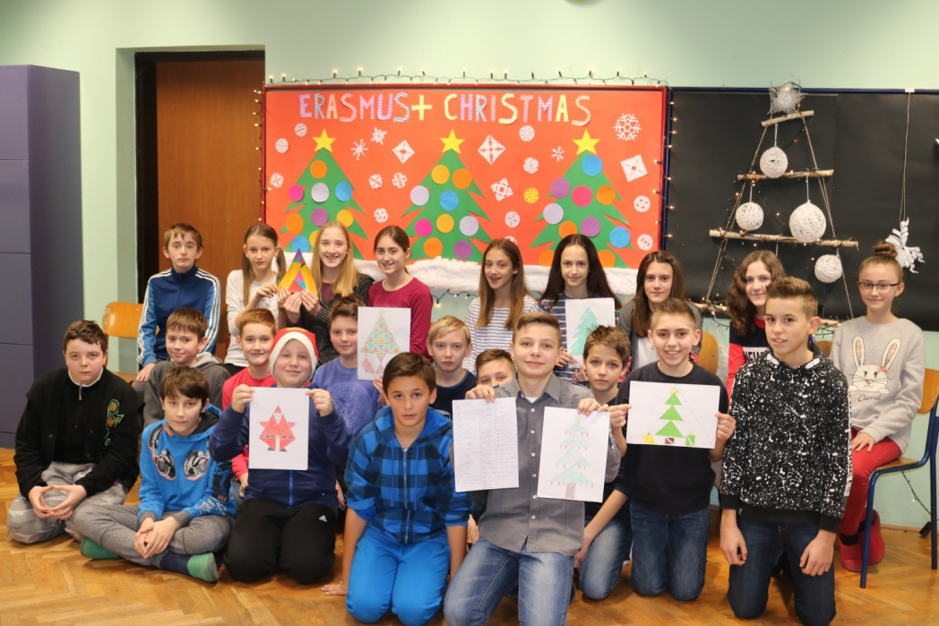
MATHEMATICS AND WHAT ELSE
In the third activity of the ERASMUS + project 'Mathematica regina omnium scientiarum et- learning the path to success' connected their mathematical knowledge to the upcoming Christmas holidays.

Slide 3
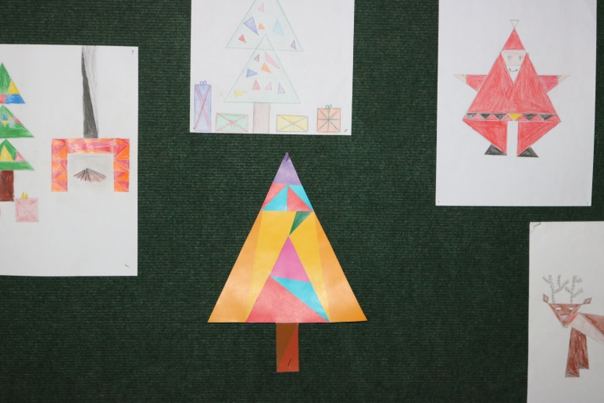
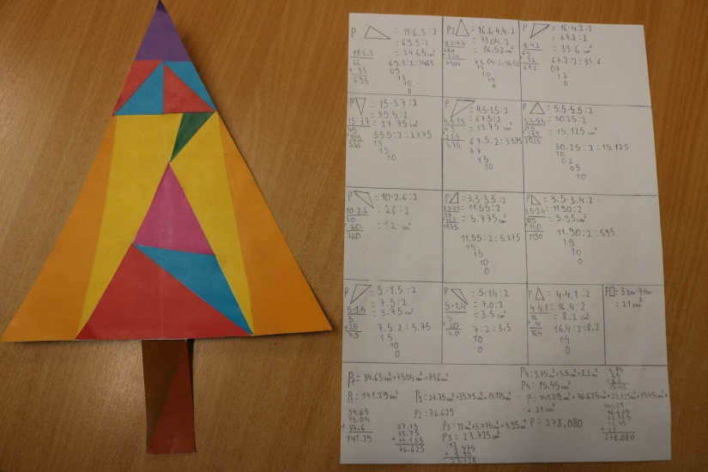
MATHEMATICS AND WHAT ELSE
Their task was to imagine a creative drawing in the spirit of Christmas with the emphasis on the shape of the triangle. They showed the coonection of Art and Math by calculating the surface of their drawings. Students have drawn a Christmas tree, presents below the tree, Santa Clause and many others and they were all made out of triangles.

Slide 4
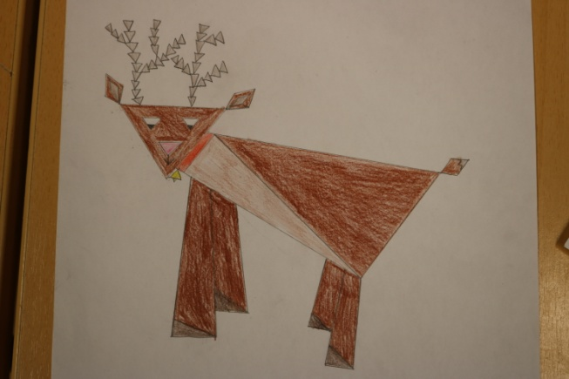
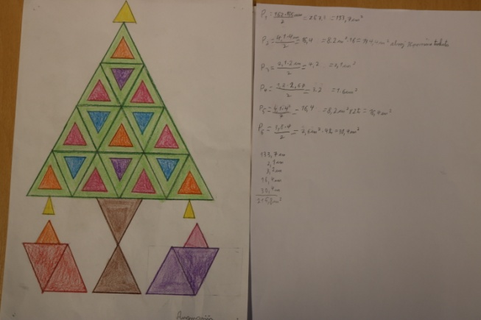
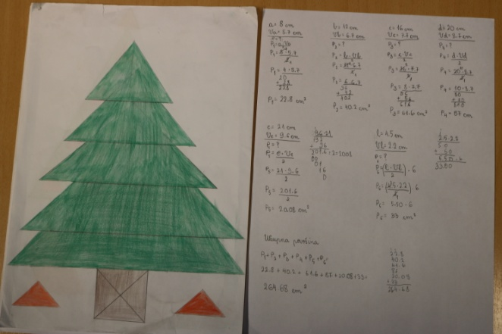
MATHEMATICS AND WHAT ELSE
The main formula that the students used in this activity was the one for calculating the surface of the triangle and the final sum of all surfaces makes out their Christmas drawing.

Slide 5
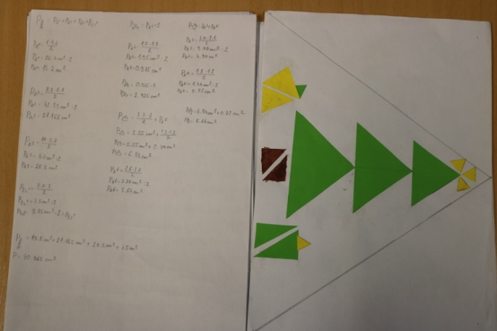
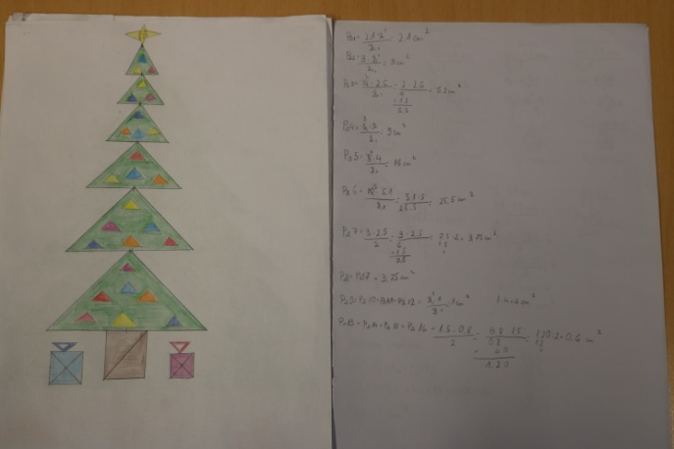
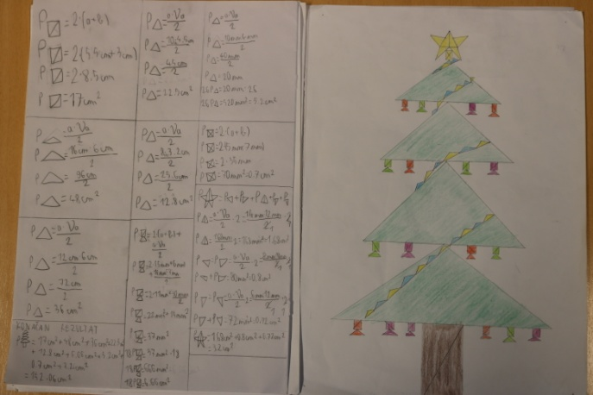
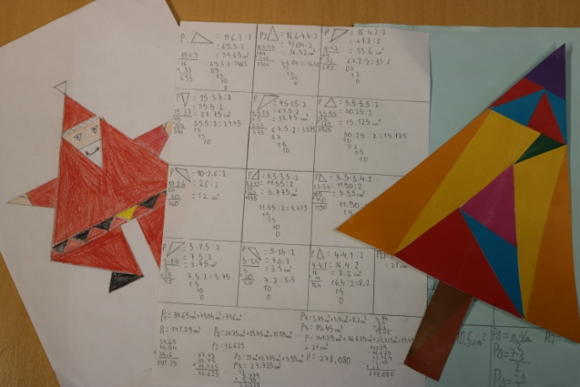
MATHEMATICS AND WHAT ELSE
This activity was designed by Math teachers Denis Vujanović i Anita Jukić and it was partly conducted in class and partly in extracurricular activities.

Slide 6
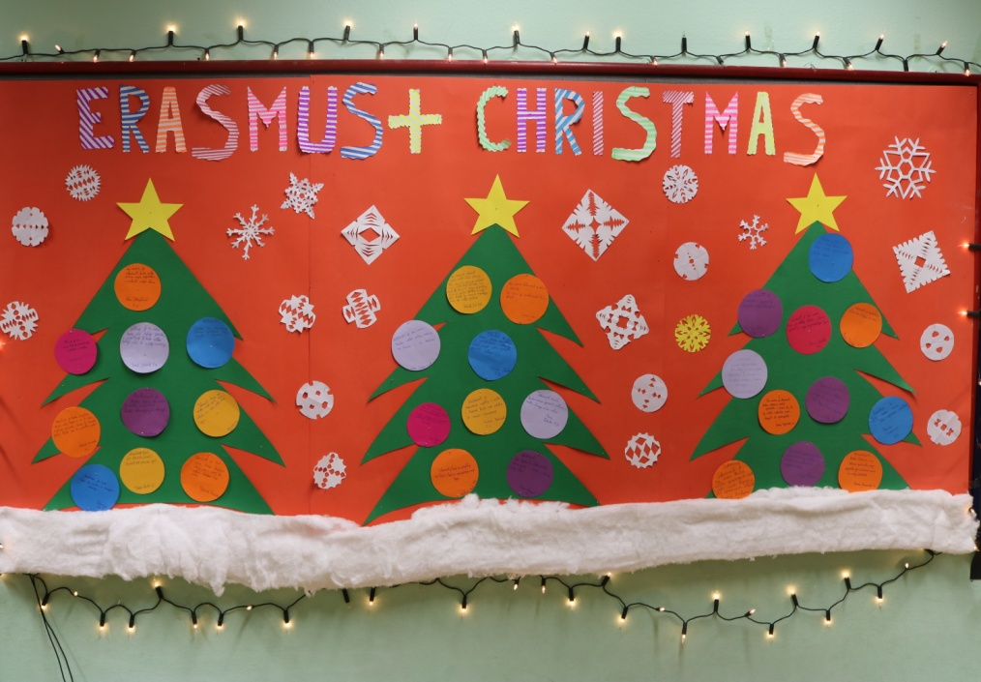
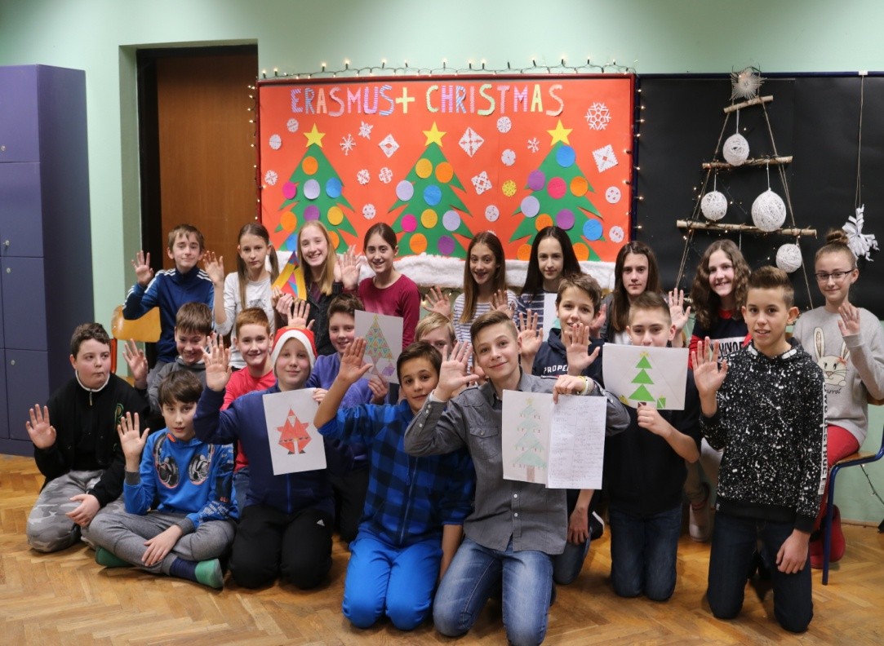
MATHEMATICS AND WHAT ELSE

