Slide 1
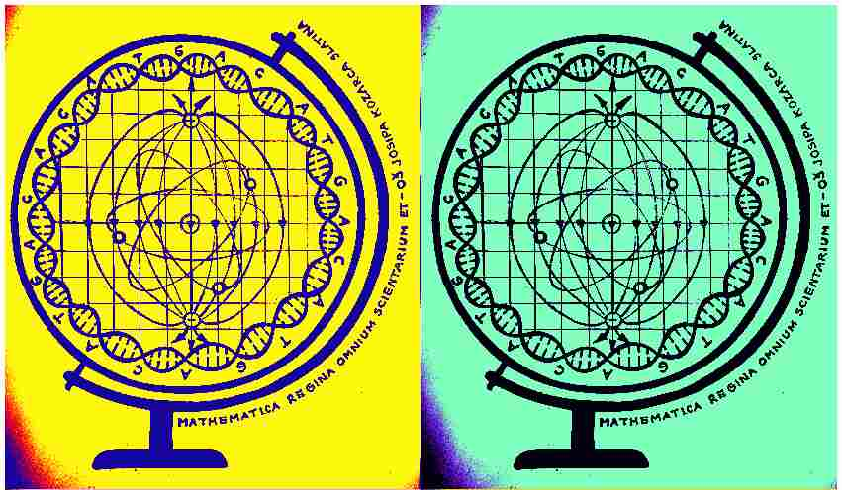
Mathematica regina omnium scientiarum et – learning path to success
Activity for February 2020

Slide 2
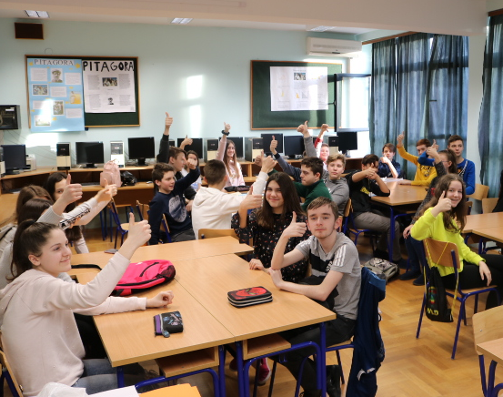
Students of the 8th grade had a workshop called ‘Man is the master of everything?’. Aim of the workshop is that students, divided into groups, collect (Statistical system of Croatia), examine and graphically display statistical data about demographic and social changes in their own region, country, Europe and around the world.

Slide 3
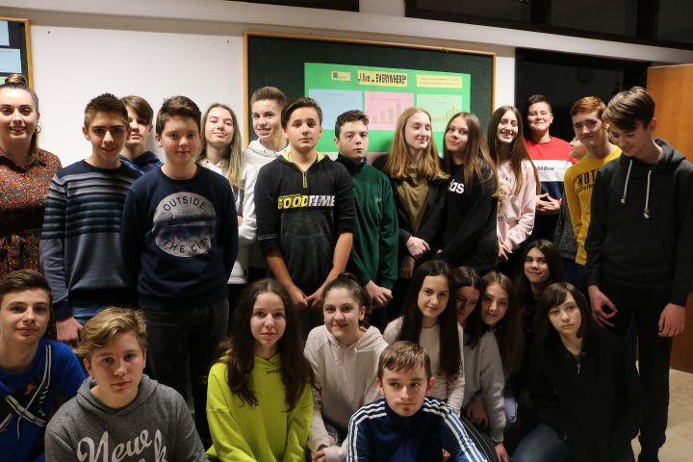
Take a look at what we did in February 2020. We hope you will like it! ☺
First group showed statistical data about external migration of inhabitants of Croatia (dzs.hr) 2009.- 2018.
Second group showed statistical data of migrations from Croatia to other countries.
Third group researched immigrants and emigrants in Virovitičko – podravska county 2014.-2018.
Based on the collected data all three groups of students made, lead by contemporary learning methods, bar and pivot diagram of migrations in the Microsoft Excel program. Learning outcomes were realized through collection and analysis of data and exhibition of the work on the project board in school which is the end-result of the activity.

Slide 4
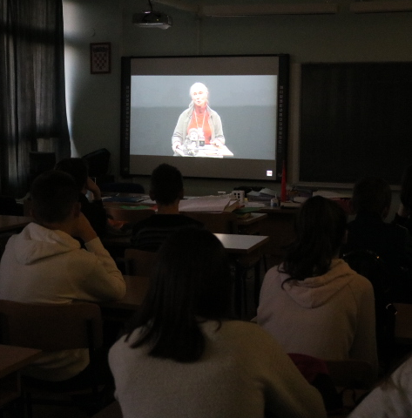
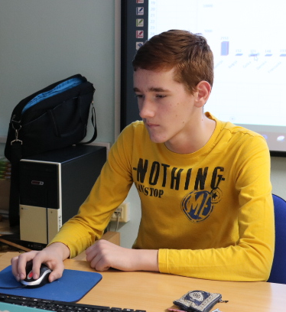
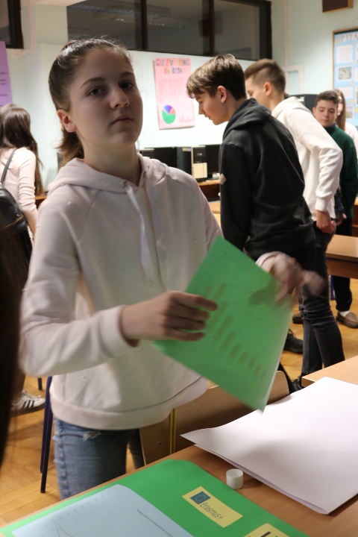
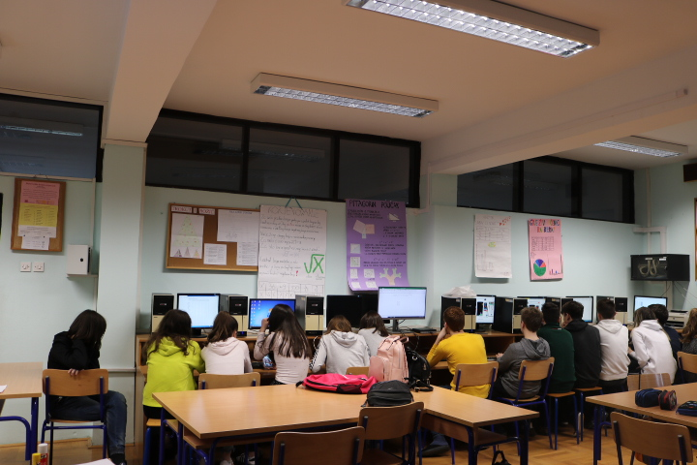
Motivation for the activity comes out of the fact that people migrate out of economic, social and demographic changes. By researching behavior of primates, their social relations where one of them represents the leader, we concluded that we behave very similar to primates. How a society of primates behaves – migrates from the area that is bad to a one that is better for life. In the civilized age of the human world this looks a little bit different even though the principles are the same. Lead by that topic, students watched a movie called ‘Jane’s journey’ – Life path of Jane Goodall’, about an English woman who researched about chimpanzees in Africa (Jane – ‘If we are the most intelligent species that ever lived on our planet, how come we are destroying it?’).

Slide 5
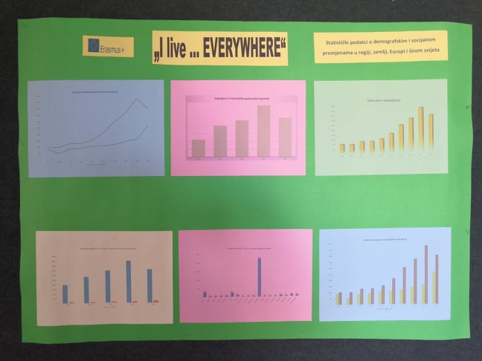
Additionally:
The activity is created and accomplished by Math teachers Denis Vujanović and Anita Jukić in cooperation with English teacher Dražena Vujanović.
The activity is accompanied by making a short film in English which will be released on a transnational meeting in Romania and Poland 2020. In purpose of making this kind of a film, the activity is translated in English and leading actors are students who present their knowledge through the activity. For documenting the activity, we are going to use multimedia equipment, photo camera, camera, internet, You Tube channel and Adobe Premiere Pro program.

Slide 6
Evaluation: We rated the activity with excellent! ☺

