Slide 1
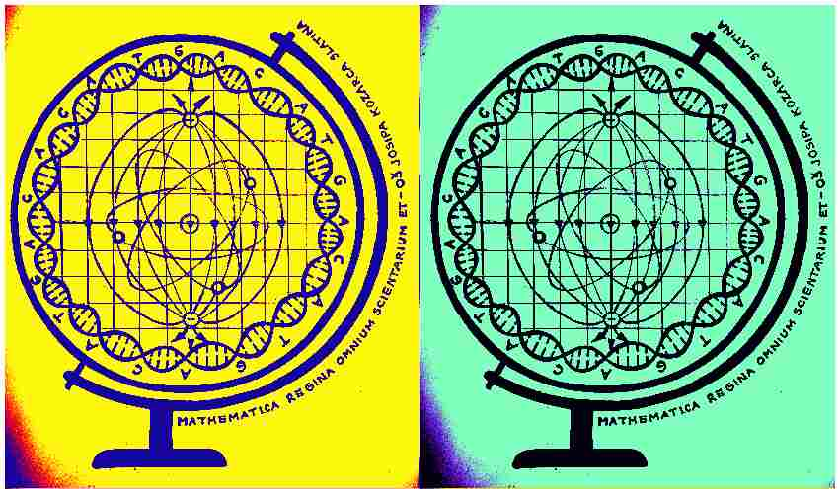
Mathematica regina omnium scientiarum et – learning path to success
HUMAN AND NATURE
Activity for March/April 2020

Slide 2
Topic of the activity: Humans and nature (activity was done entirely online)

Slide 3
Description of the activities:
watching of a catastrophe movie The Impossible (2012.)
expression of emotions about the movie with exit cards
solving a movie quiz
watching a presentation about the movie and the true event (tsunami of 2014.) on which the movie is based
creative expression of students – blackout poetry based on the Letter of an Indian chief of Seattle

Slide 4
Aims of the activities:
develop the awareness of students regarding the harmful relationship of man towards nature (pollution, overexploitation of resources, destruction of the environment etc.) and consequences of that negative influence (natural catastrophes, volcanic eruptions, fires, floods…)
encourage students for critical thinking and consideration of the environmental problems
awaken the feeling of awe towards nature instead of the attitude that nature should serve humans
encourage students' creative expression about Earth and environment protection
Develop students' digital competences

Slide 5
Motivation for the activity…
…comes out of the fact that the problems of environment protection and sustainable development are always current and significant, especially now in the time of the pandemic of the coronavirus which has a bad influence on humanity while, at the same time, nature is recovering from the harmful treatment of people against their environment.

Slide 6
Modern methods of work:
creative writing method – creative expression of students with the blackout poetry technique
e- learning (networked learning) – project activities done in online environment by using various digital tools (Bookwidgets, Genially, YouTube) in a virtual classroom on Yammer

Slide 7
Teaching aims:
Student will be able to:
express their emotions regarding the seen movie
creatively express themselves encouraged by a movie
recognize the negative role of humans in the environment pollution
Become aware of the importance of environment protection and sustainable development

Slide 8
Results of the activities:
Students will become aware of the negative effect of humans towards nature and they will develop their awareness of the importance of environment protection and the necessity of sustainable development. Their thoughts about the mentioned problems will be expressed through creative work technique of blackout poetry based on the Letter of the Indian chief of Seattle about the relationship of humans and nature.

Slide 9
Everything we have done is in this interesting presentation (on Croatian)
Blackout poetry
In the presentation
you can see
the poetry
of our students
https://view.genial.ly/5ea951bbd005980d8907c293/presentation-covjek-i-priroda
Some of examples

Slide 10
Correlation with Mathematics
Students drew and calculated two tasks with data from the film - more precisely, with curiosities from the shooting of the film Impossible. Here is the video: https://www.youtube.com/watch?v=Ll1VKuZyYrs&t=8s
TASKS
Data from the making of the movie Impossible: depth of the channel 15m, length of the channel 60m, 35 pumps.
a) How many tons of water is necessary so that the depth gets to 80cm?
b) If there were 5 pumps at the end of the channel and the rest of them were evenly spaced along the channel, what was the distance between two pumps?

Slide 11
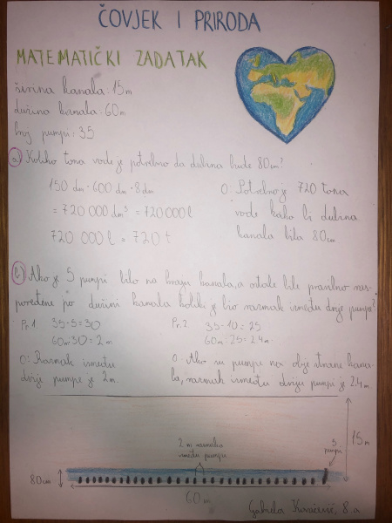
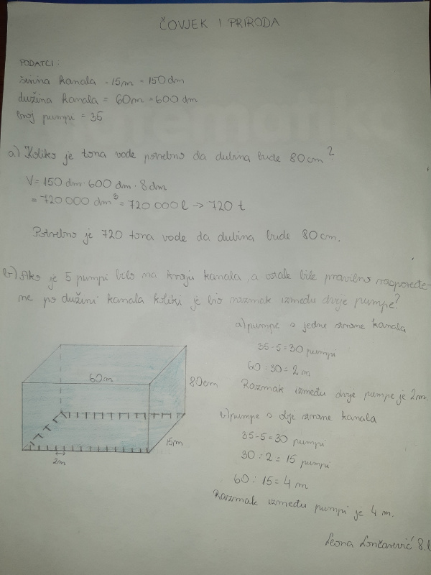
Student works (photographed because distance learning)
Sara Čaglić
Leona Lončarević
Gabriela Kovačević

Slide 12
Thank you for your attention! ☺
Additionally:
The activity is created and accomplished by Croatian teacher Hana Tepeš, Math teachers Denis Vujanović and Anita Jukić in cooperation with English teacher Dražena Vujanović.

