Slide 1
Mathematica regina omnium scientiarum et – learning path to success
HOW MUCH PHYSICS IN CHEMISTRY
Activity for February 2018

Slide 2
HOW MUCH PHYSICS IN CHEMISTRY
On 28th of February there was a workshop for 6th grade students with the topic ‘How much Physics in Chemistry?’ Students used equipment that is used in both physics and chemistry to conduct the following experiments:
Detection of the volume of an irregular body
Tower of density
Conductivity of solids and liquids

Slide 3
HOW MUCH PHYSICS IN CHEMISTRY
Detection of the volume of an irregular body
Students were offered a few irregularly shaped bodies (a rock, a weight, a piece of plasticine) and they were supposed to detect the given bodies volume by using the principle of the Archimedes law. They were also given a graduated cylinder with water as a measuring instrument. Students came to their conclusions independently by using the method of assumption and they realized that they should put the object in water and then measure its volume. Later on, they changed the shape of the plasticine and checked if it influences the volume of the irregular body.

Slide 4
HOW MUCH PHYSICS IN CHEMISTRY
Tower of density
Students brought a few differently colored liquids from home and the goal of this experiment was to put in as many different liquids as possible in the graduated cylinder without them mixing. We used: water, oil, dish soap, shampoo and antifreeze liquid. Pouring in different types of liquids makes them stay in layers because each of them has different density.

Slide 5
HOW MUCH PHYSICS IN CHEMISTRY
Conductivity of solids and liquids
Students closed the electric circuit with various objects out of their pencil cases. They realized that metals conduct electricity the best. Then they examined the conductivity of different liquids. The students noticed that water will conduct electricity better if they put a little salt in it and they also noticed that bubbles appear with one of the conductors. When they examined the conductivity water solution of cupric sulfate anhydrous on one of the immersed conductors they put a coin on it. The coin became copper because of the decomposition into elements of the chemical compound of water solution of cupric sulfate anhydrous by using electricity.

Slide 6
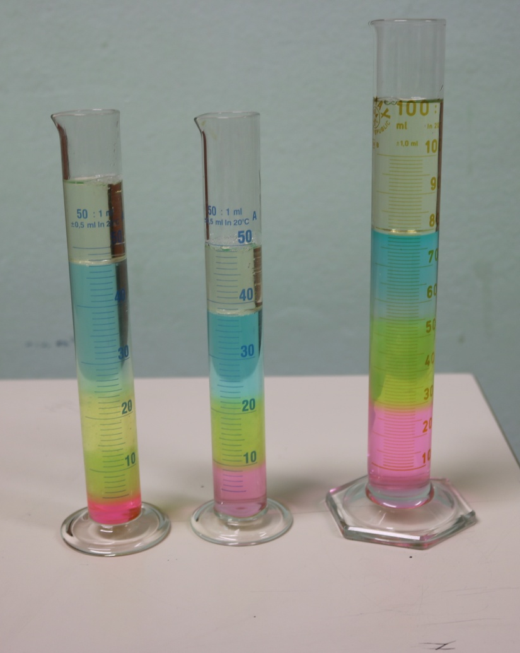
HOW MUCH PHYSICS IN CHEMISTRY
The experiments were created by Physics teacher Martina Bukvić and Chemistry teacher Ivana Kotarski Milek

Slide 7
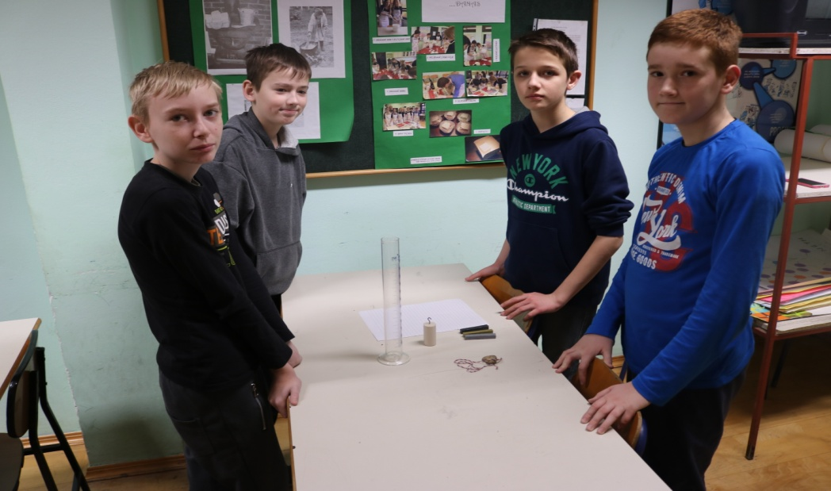
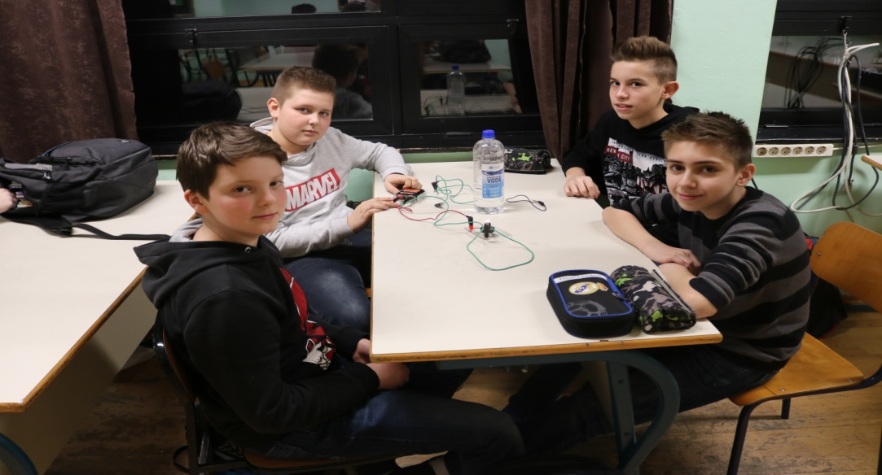
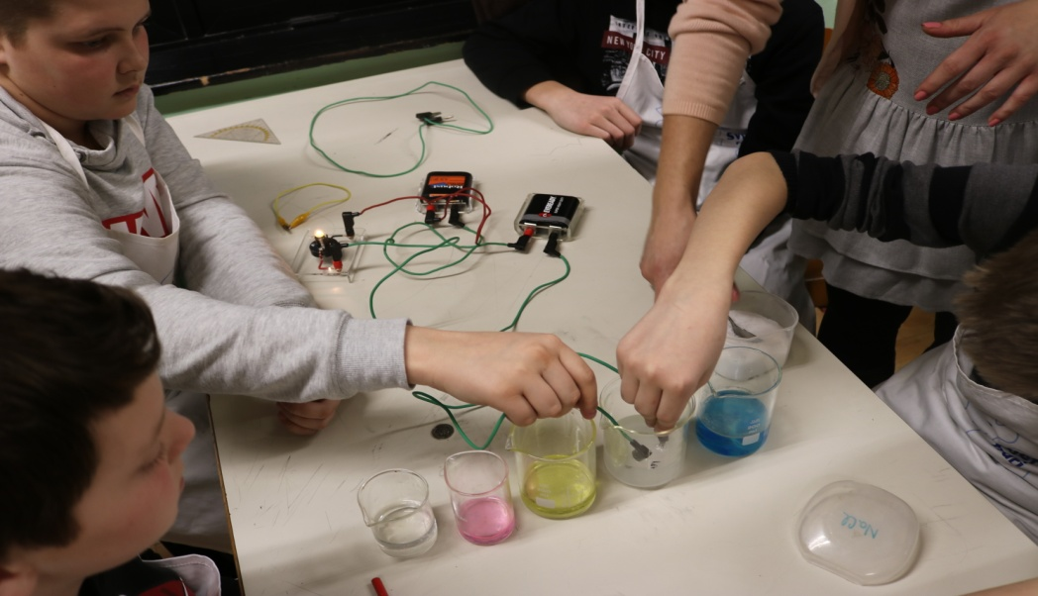
HOW MUCH PHYSICS IN CHEMISTRY

Slide 8
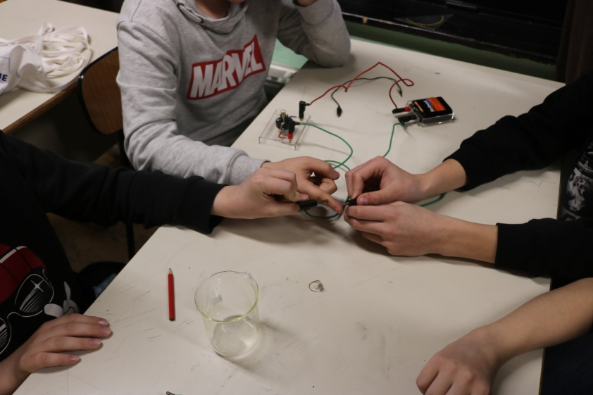
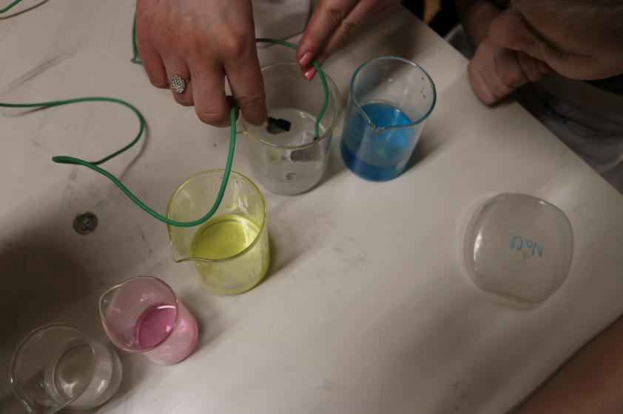
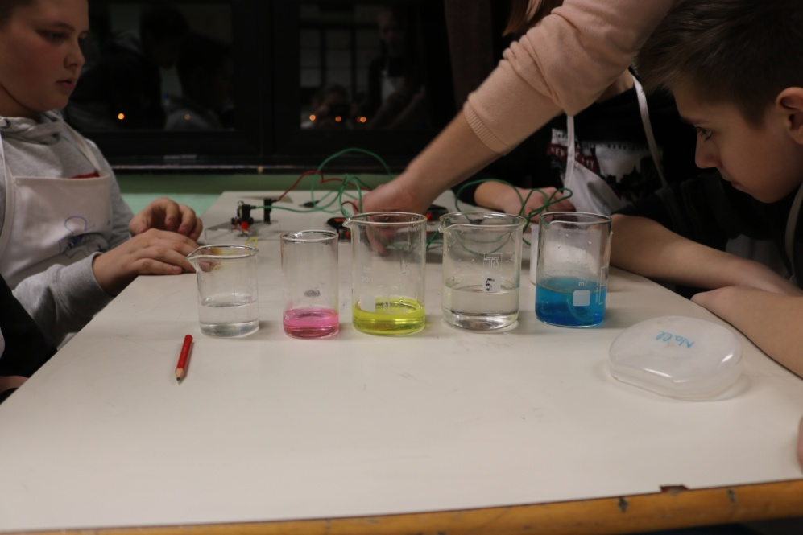
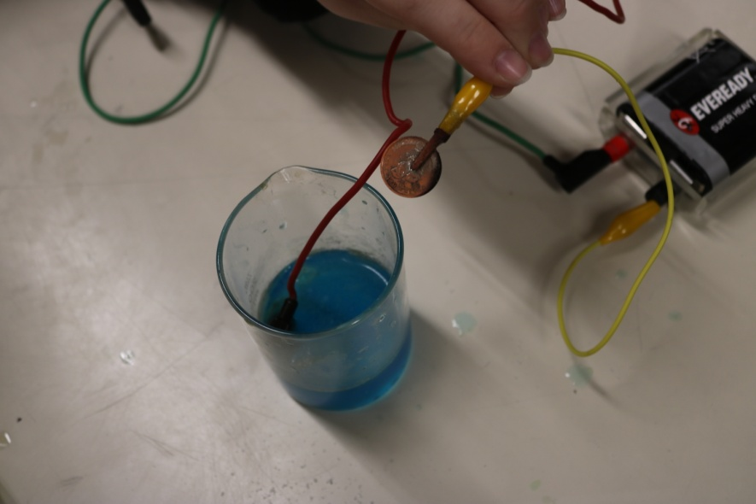
HOW MUCH PHYSICS IN CHEMISTRY

